Slide 1
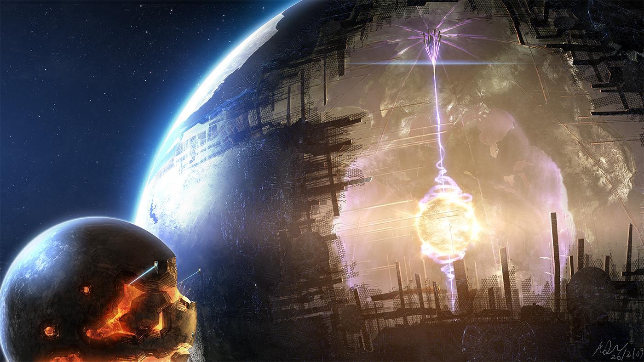
Creating
Infinite
Worlds

Slide 2

Who Am I?
Software developer (10 Years)
BS Degree in Computer Science
Hobbyist video game programmer
Rotating DM for 3 D&D groups over 5 years

Slide 3
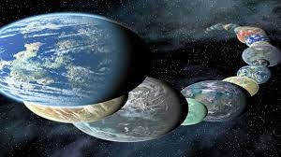
Presentation Contents
What can I use this for?
What defines an infinite world?
How do video games create worlds? (Uh oh! Math!)
Simple at home world creation
Final notes
Q & A

Slide 4
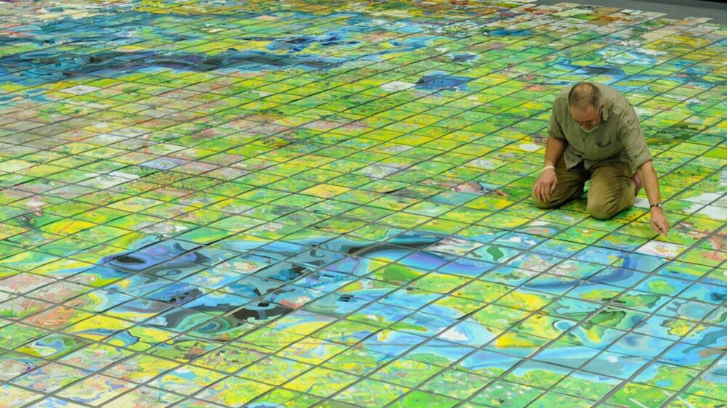
Use Cases
Video Games
Novels
Tabletop RPGs (DnD, WoD, etc)
Art
Hobby (Jerry’s Map)

Slide 5
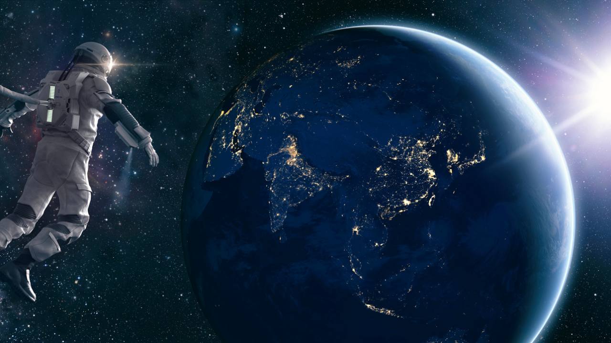
Infinite Worlds
Established by a set of rules
Contains Actors
Just add water!

Slide 6
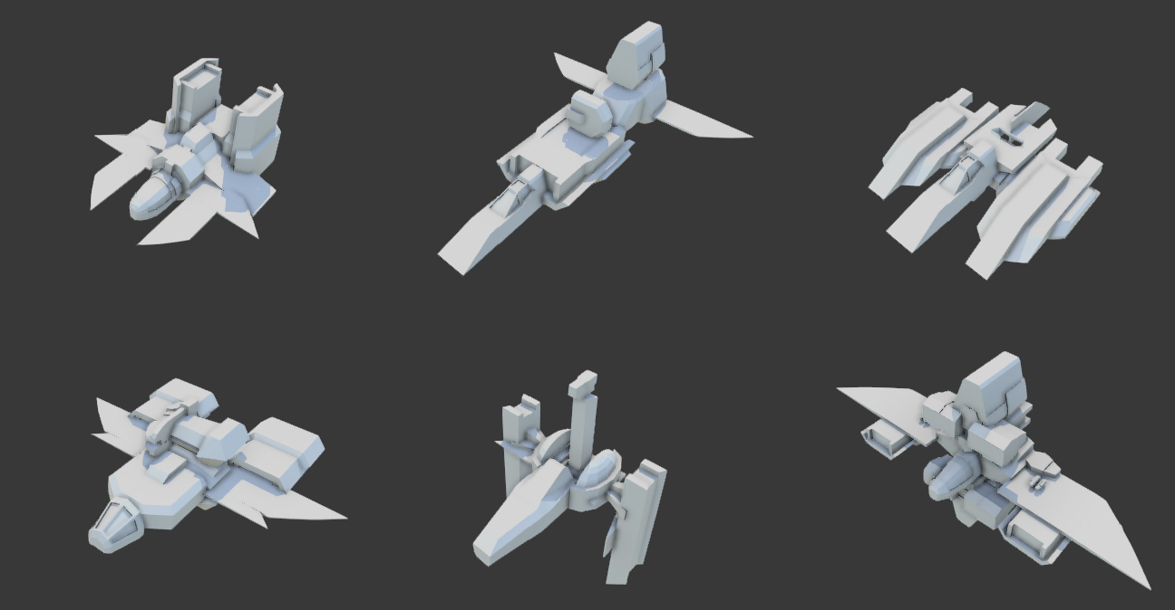
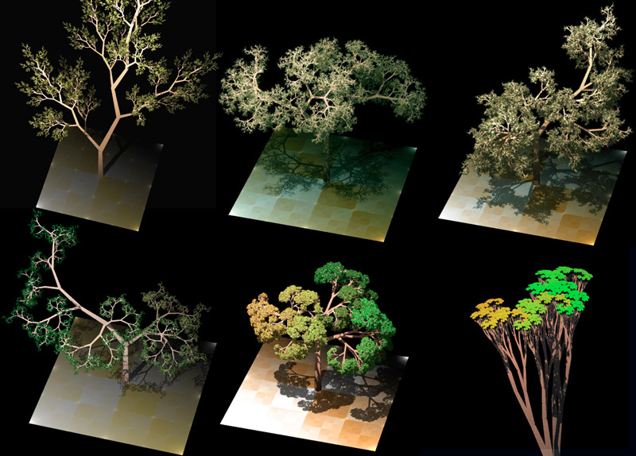

Procedural Generation
is a method of creating data algorithmically as opposed to manually, typically through a combination of human-generated assets and algorithms coupled with computer-generated randomness and processing power.

Slide 7
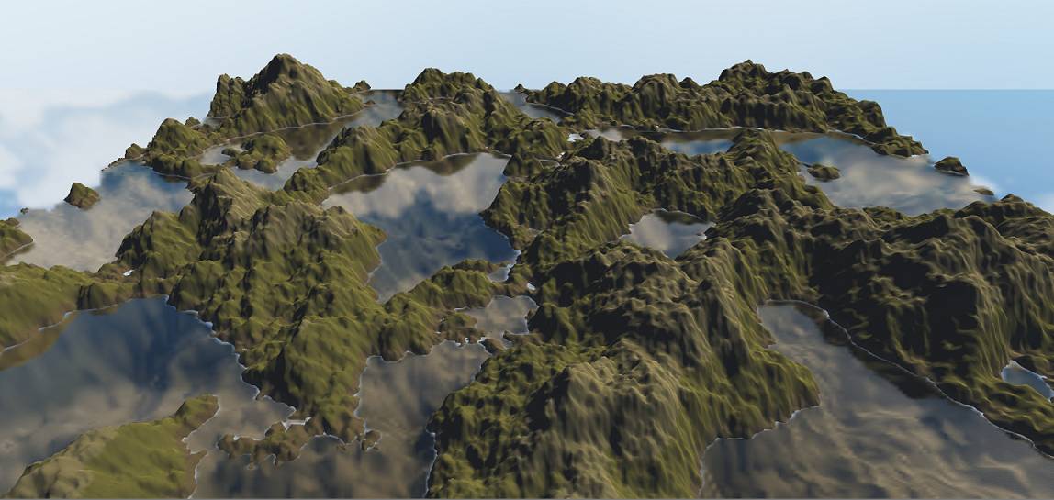
Terrain Generation
Repeatable Ruleset
Fully isolated
Seed Value

Slide 8

Purely Random (Noise)

Slide 9
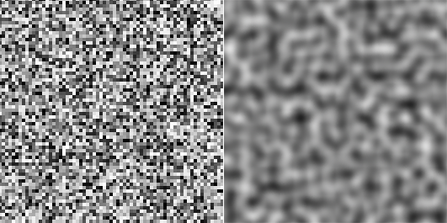
Perlin Noise

Slide 10
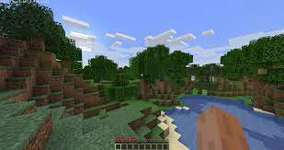
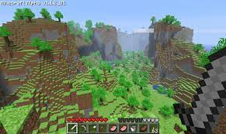
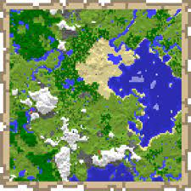
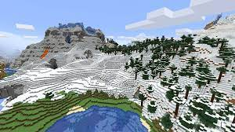
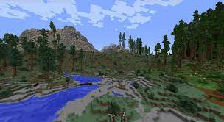
Minecraft

Slide 11
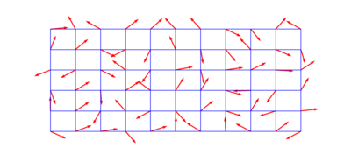

Math Explanation

Slide 12
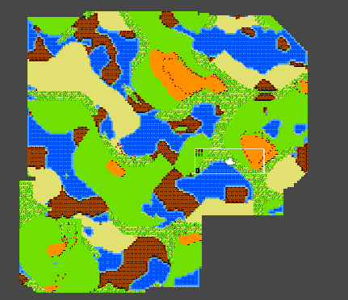
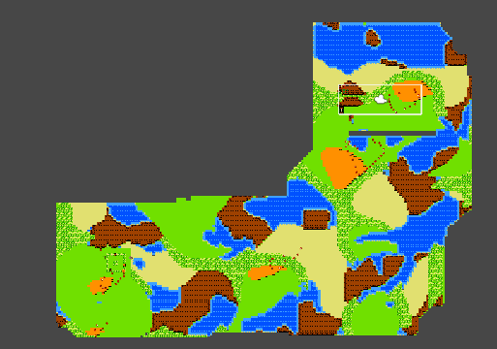
On Demand Generation

Slide 13
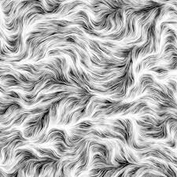
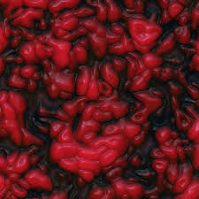
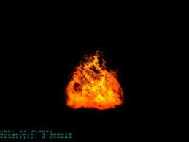
Perlin Examples

Slide 14
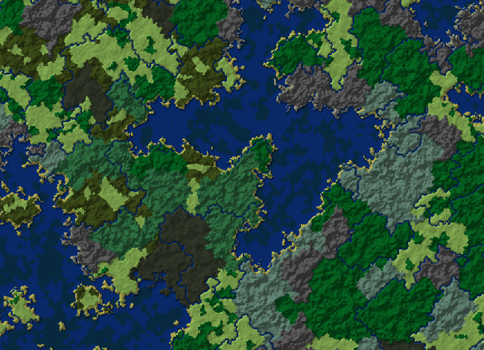
Where are the Rivers?

Slide 15
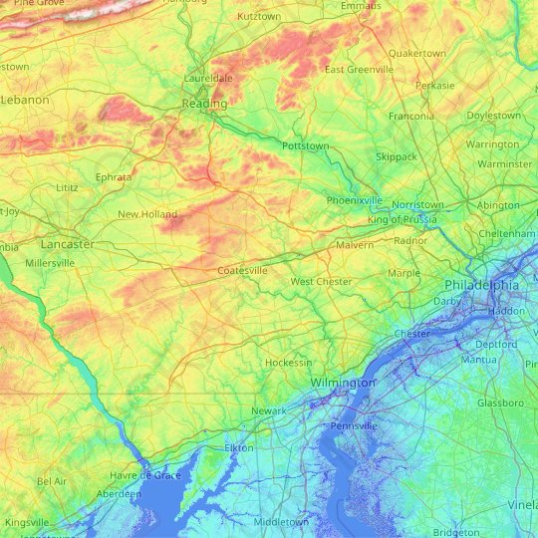

Slide 16
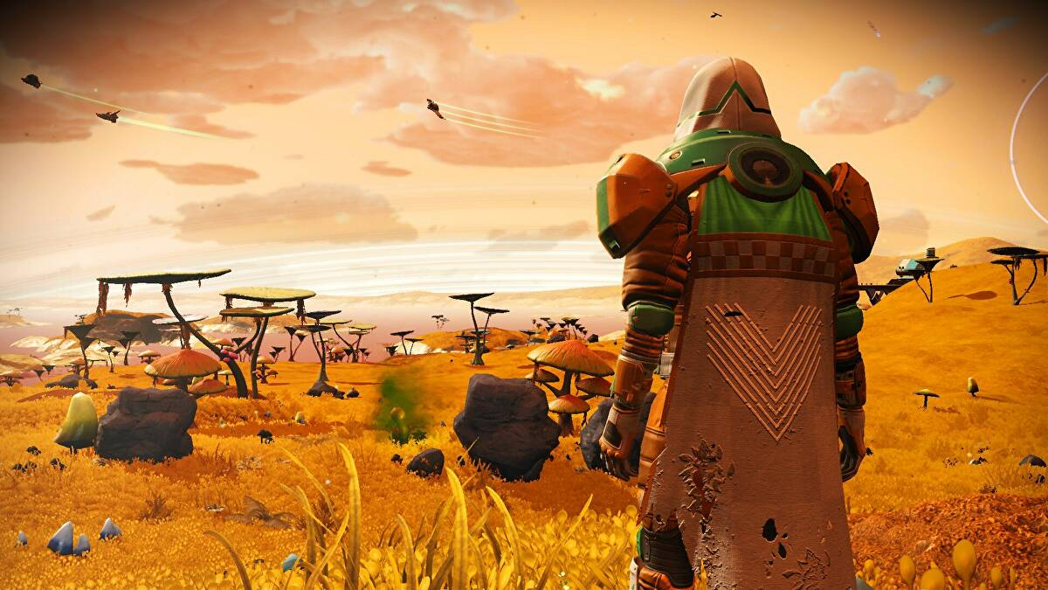
No Man’s Sky

Slide 17
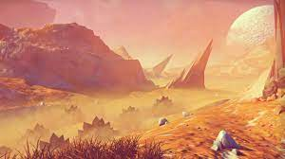
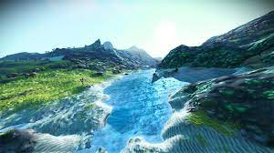
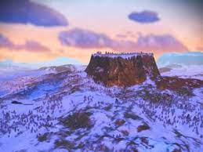
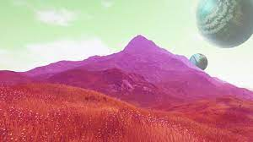
Terrain Examples

Slide 18
Uber Noise
Domain Warping
Slope Erosion
Altitude Erosion
Ridges
Plateaus
Terraces
Rolling Hills
Non-repeating features
Analyitical Derivative

Slide 19
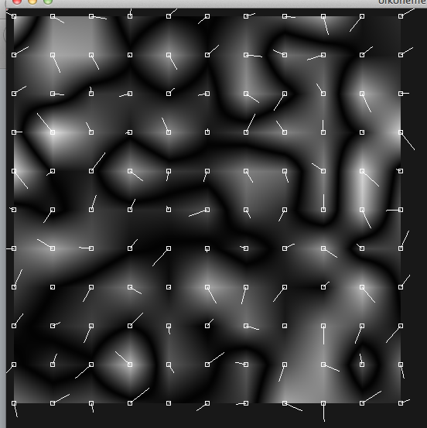
Gradient Randomization

Slide 20
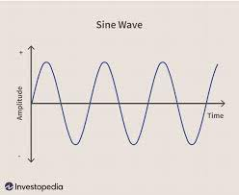
Sine Functions

Slide 21
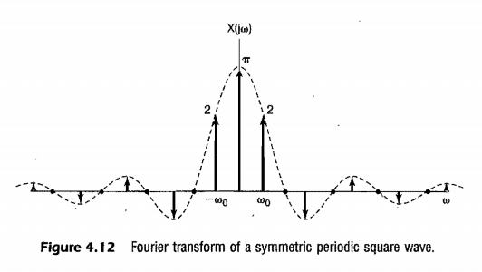
NMS Gradient Function

Slide 22
How to Use?

Slide 23
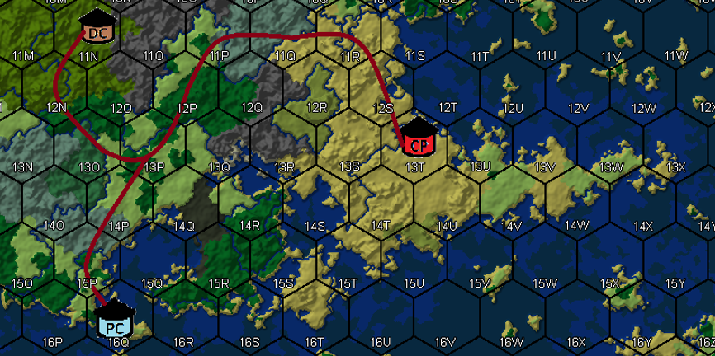
mineatlas.com

Slide 24

World Creation By hand

Slide 25


Slide 26
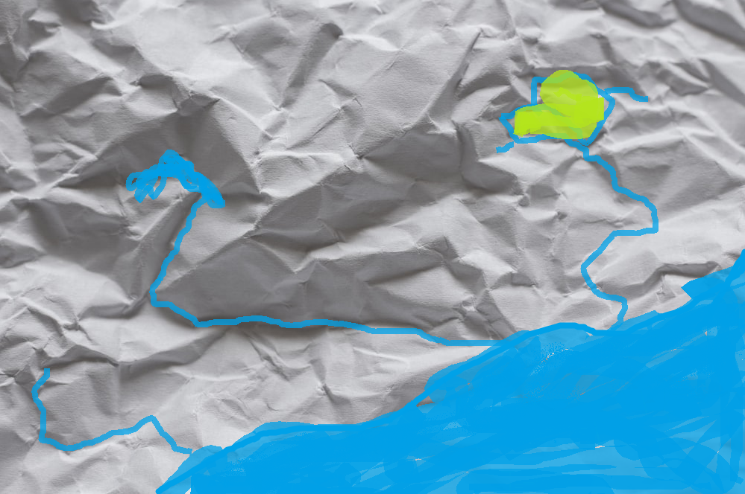

Slide 27
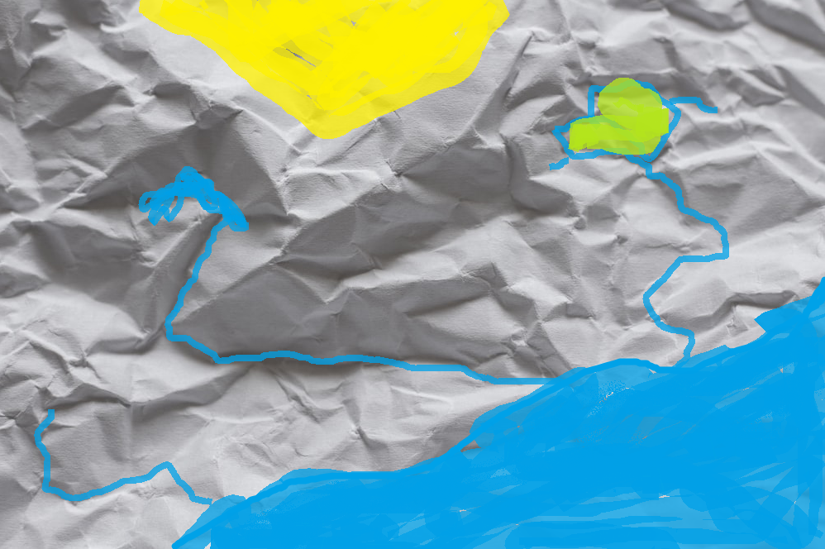

Slide 28
Adding Actors
Actors can be individuals, groups, or even weather (President, Country, Volcano)
Actors have needs and wants
Actors are greedy and want to expand

Slide 29
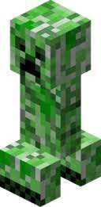
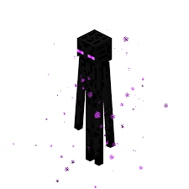
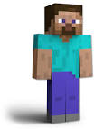
Minecraft Actors

Slide 30
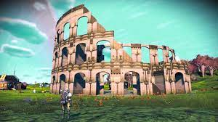
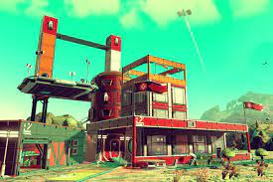
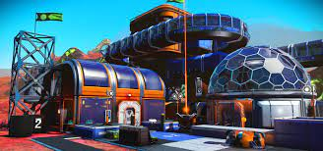
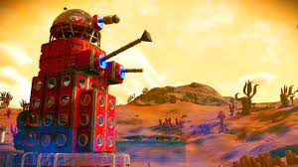
NMS Actors

Slide 31
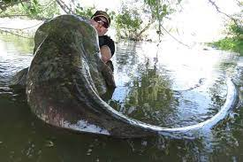
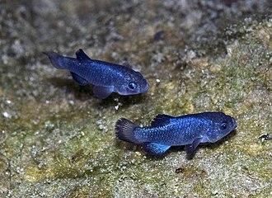

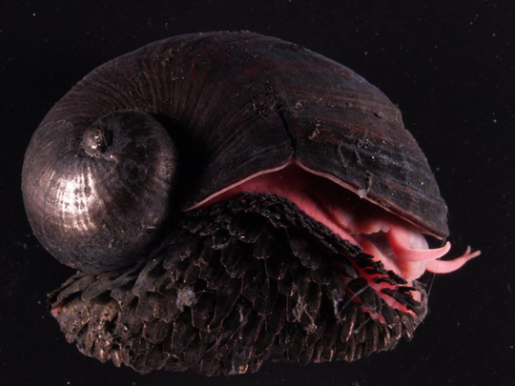
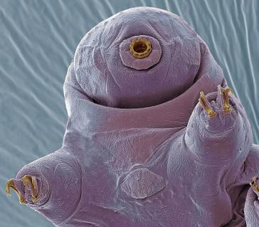
Water creates life

Slide 33
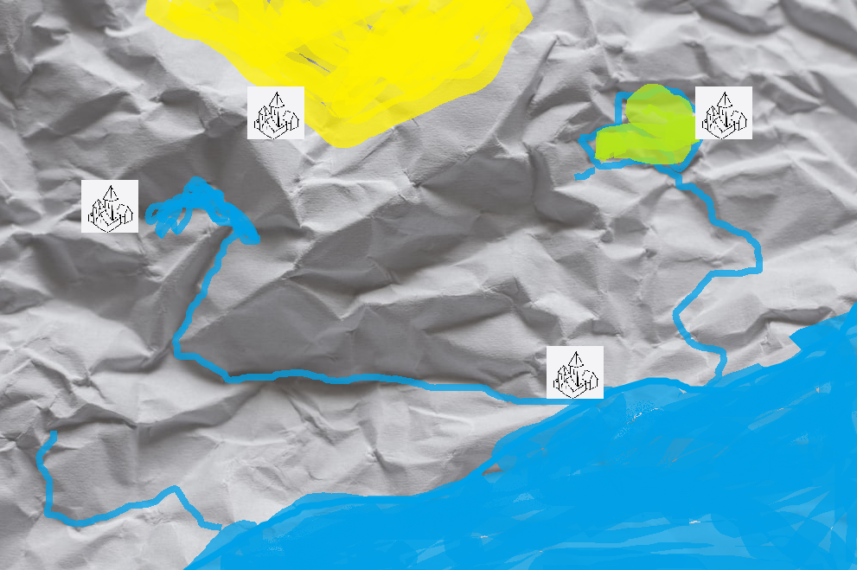

Slide 34
Naming Places
People
Geography
Animals
Joke

Slide 35
Examples
Wyoming - Rolling Planes
Tunkhannock - Little Stream
Tobyhanna - a stream whose banks are fringed with alder
Susquehanna - Muddy River
Kaaterskill - (dutch) Big Cat Creek
Schuylkill (River) - (dutch) Hidden River
Plymouth Meeting - A place for people from Plymouth to meet
Plymouth - The mouth of the Ply river
Intercourse - Cross Keys or “Enter Course”
Egg Harbor - Smells like eggs
Devil’s Hole PA - Bottomless lake that sent you to hell

Slide 36
Desart
Marshome
HiLaken
Lamouth

Slide 37
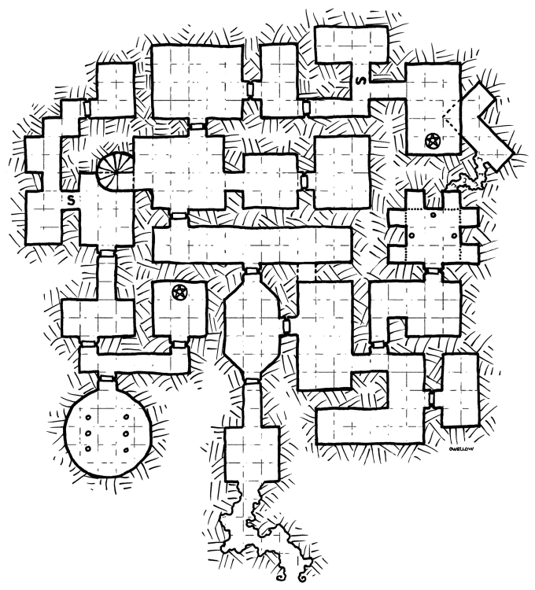
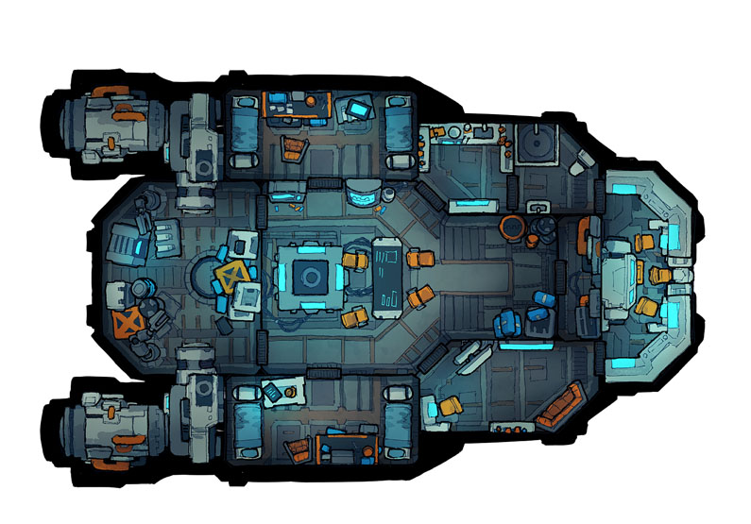
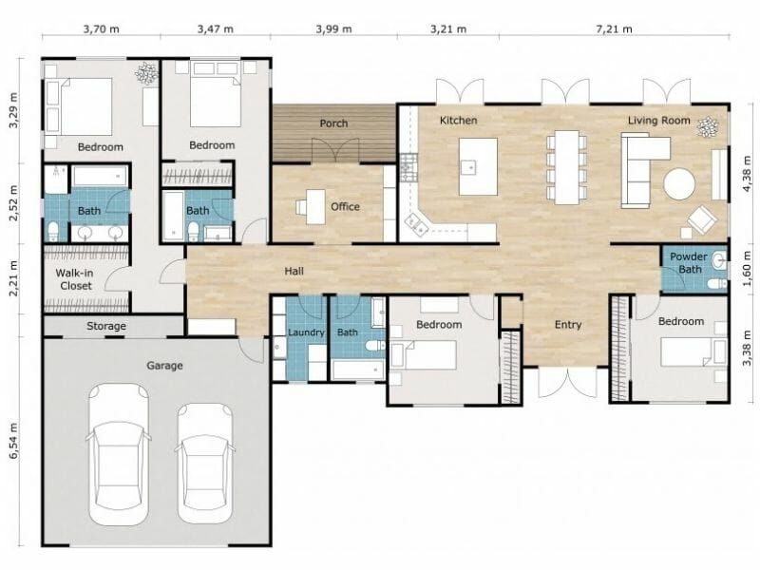
What about Confined Spaces?
Known Space Size
Known space can be more complex
Needs to be reachable
Calculations don’t need to be continuous

Slide 38
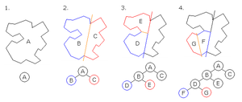
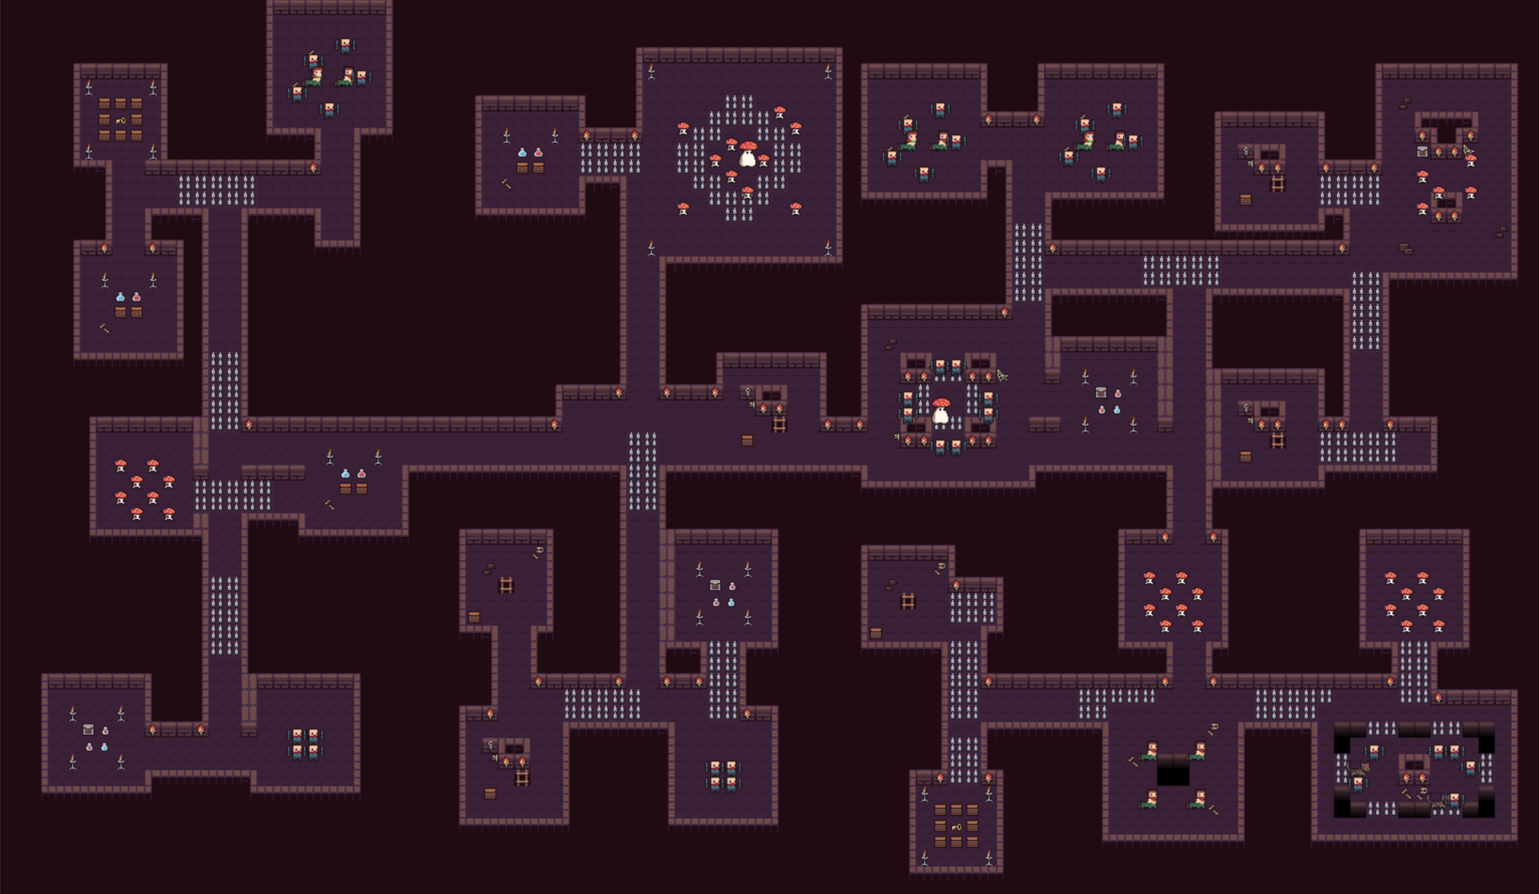
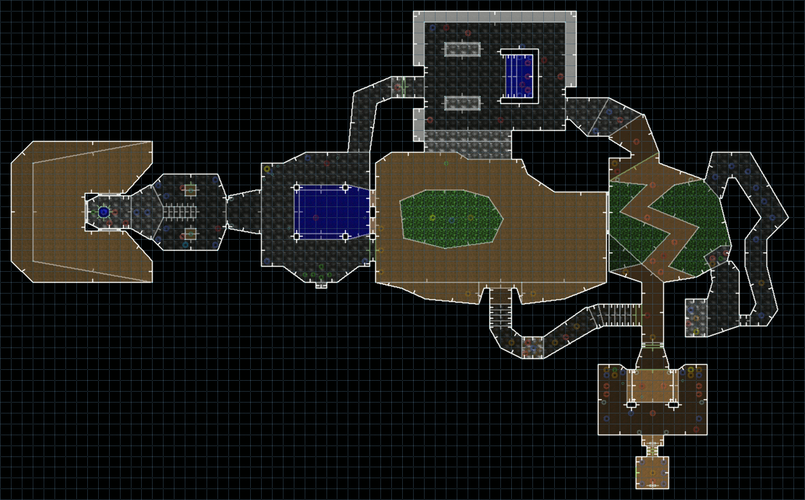
Binary Space Partitioning

Slide 39


Slide 40


Slide 41


Slide 42


Slide 43



Your World is yours
Rivers can split (River Bifurcation)
Tidal forces can generate natural canals
The world doesn’t have to spin
It doesn’t even have to be flat

Slide 44
Q & A
michaeltroyjr@gmail.com
Helpful Links
  http://www.jerrysmap.com/
  http://mineatlas.com/
  https://donjon.bin.sh/

